Slide 1

Deep Learning-Based Facial Landmark Detection Using Modified ResNet-18 Architecture
A College Project Presentation

Slide 2
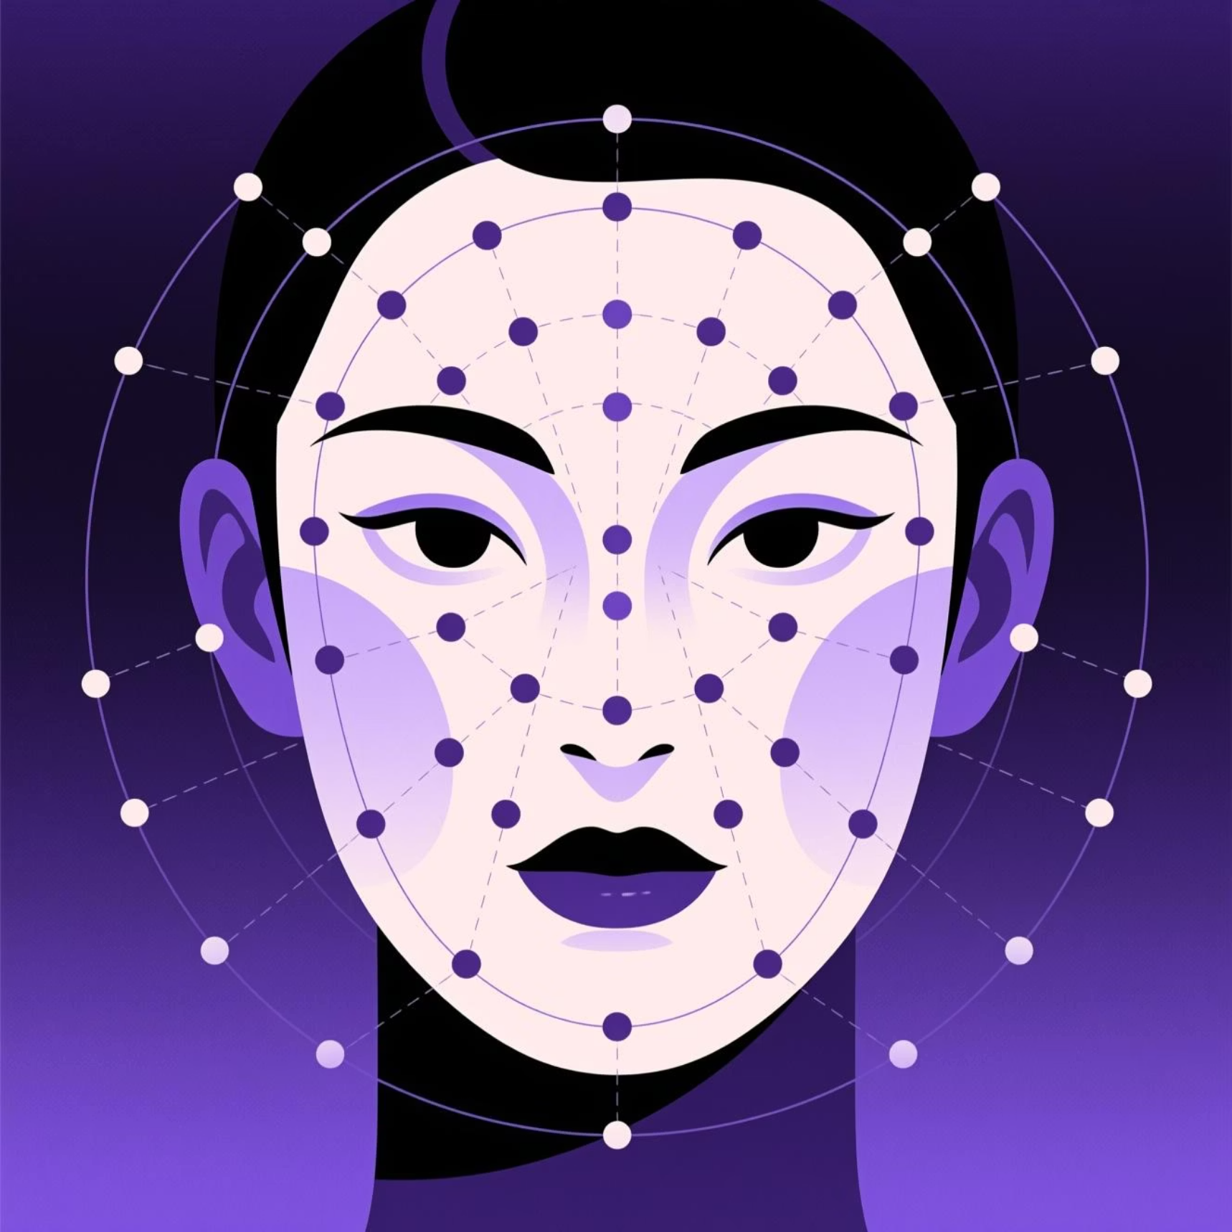

Problem Definition
The Challenge
Facial landmark detection identifies critical facial points including eyes, nose, mouth, and jawline contours. Traditional computer vision methods struggle significantly when confronted with real-world complexities.
Key limitations:
Lighting variation degradation
Pose and angle changes
Partial occlusion handling
Low accuracy with handcrafted features
Problem Statement: Develop a modified ResNet-18 deep learning architecture to accurately predict 68 facial landmarks from grayscale images, achieving improved robustness under challenging real-world conditions including variable lighting, diverse poses, and occlusions.

Slide 3


Project Abstract
Core Application
Proposed Solution
Facial landmark detection powers critical technologies: face recognition systems, emotion analysis, augmented reality/virtual reality experiences, and human-computer interaction.
Modified ResNet-18 convolutional neural network architecture learns facial features directly from raw data with minimal preprocessing, eliminating dependency on handcrafted features.
Key Advantages
Addresses fundamental challenges including lighting variations, pose changes, and partial occlusions while delivering stable, accurate predictions in diverse real-world scenarios.

Slide 4

Motivation & Industry Need
Critical Applications
Biometrics & Security
Secure authentication and access control systems
Animation & Entertainment
Motion capture and facial animation production
AR/VR Technologies
Immersive experiences and avatar generation
Human-Computer Interaction
Gesture recognition and emotion-aware interfaces
Why Modified ResNet-18?
Lightweight Architecture
Robust Feature Learning
Real-World Adaptability
Enables real-time performance on edge devices without sacrificing accuracy
Deep residual connections capture complex facial patterns automatically
Handles challenging conditions including poor lighting and partial occlusions

Slide 5

Thank You!
Questions & Discussion
We welcome your feedback and questions about our deep learning approach to facial landmark detection.

